Slide 1






ML-Based Calibration set for FTIR Backward Compatibility
2/8/2025

Slide 2

Agenda
1) Introduction
2) Problem Statement
3) Project objective
4) Scope of work
5) Challenges & Limitations

Slide 3
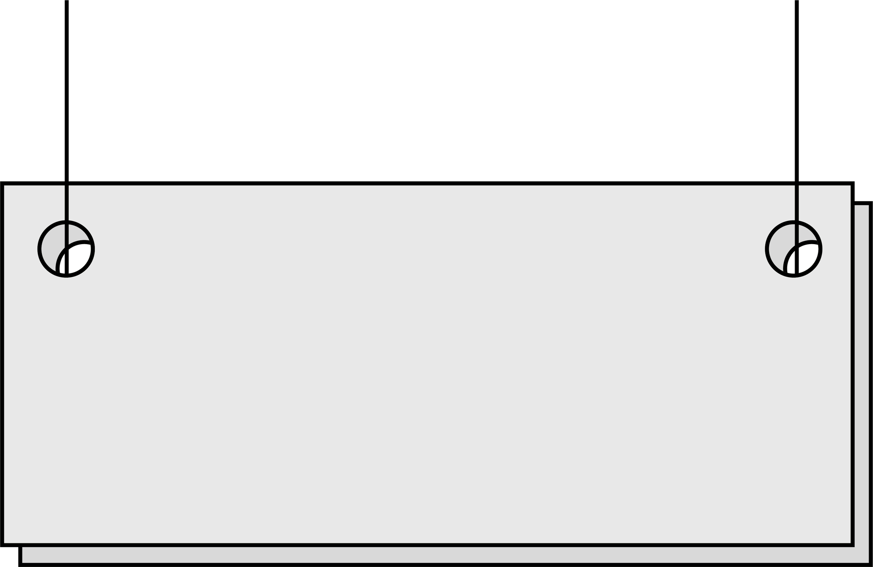
Introduction
Spectroscopy
Absorbance Technique
NIR Spectrum
Spectrometer FTIR

Slide 4

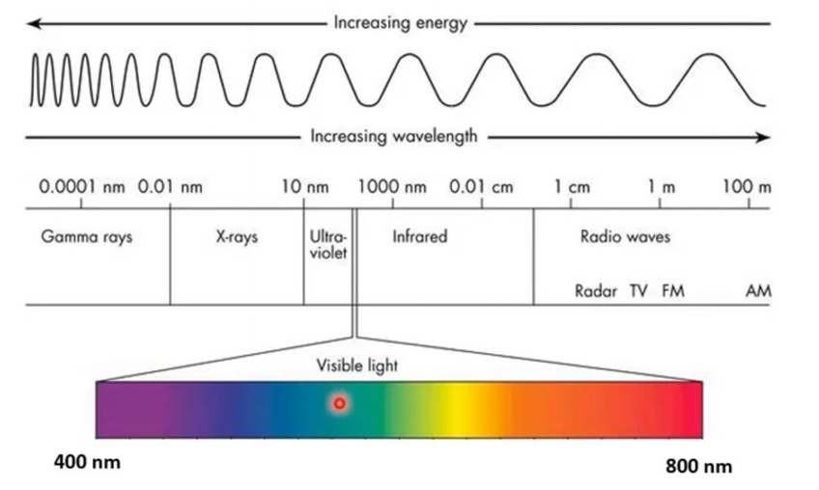
Spectroscopy
the study of the interaction between (EMR) and matter
Near-IR region
W.L = 0.78 – 2.5 µm
Absorption
Transmission
Reflection
Scattering
W.N = 4000 – 12800 cm⁻¹
Molecules for powder ingredients with uniform wavelength and homogeneous mixture

Slide 5

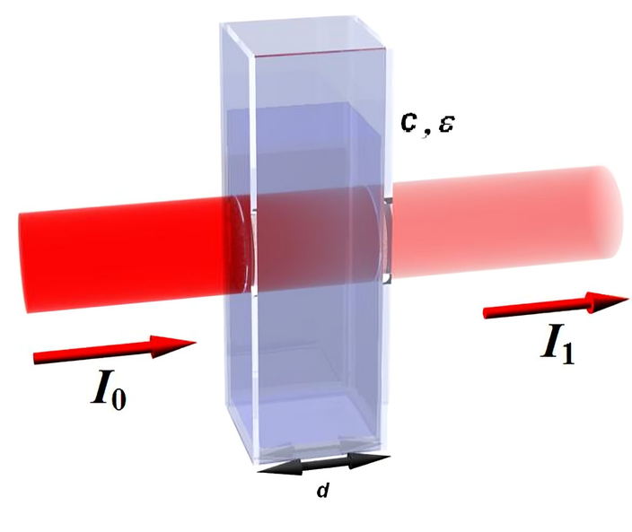
Absorbance Technique
Chemical analyzers use Beer–Lambert’s law
The amount of light absorbed by a substance is proportional to:
Concentration of the substance
Length of the light path (path length)
A=log10​(1/T)

Slide 6
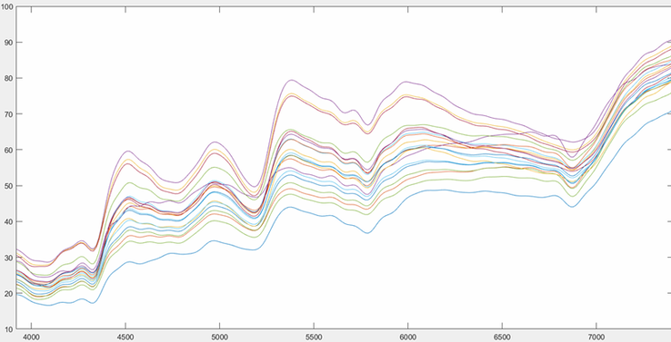
NIR Spectrum
motion between atoms
Matters --> molecules linked by chemical bonds, and these bonds are in a constant state of vibration.
Absorption Conditions (Functional Group):
The bond must contain hydrogen (such as C–H, O–H).
The bond must be asymmetric.
The energy (or frequency) we drop must be close to the natural vibrational energy of the bond.
Transmission %
Peak
Wave number

Slide 7
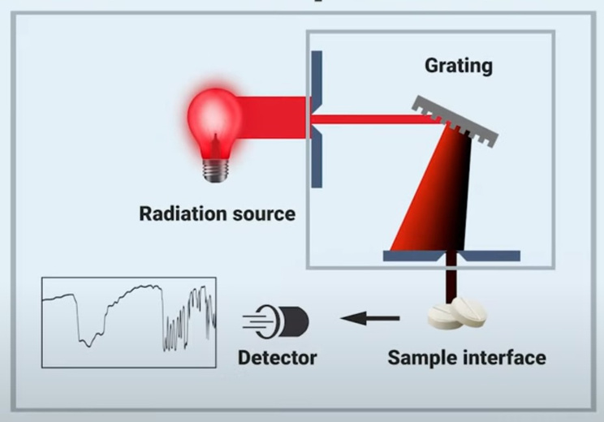
FTIR Spectrometer
It does not measure frequencies directly; it measures the superposition of signals. Fourier Transform
Components:
Infrared source
Interferometer
Sample holder
Detector
Fourier Transform software
Why used:
Fast (quick)
Does not damage the sample (non-destructive)
Accurate in analyzing chemical bonds
Works on a variety of conditions.

Slide 8
Problem Statement
Modern FTIR spectrometers, especially newer or miniaturized models, may produce spectra that differ from older hardware versions.
These spectral differences create incompatibility across devices.
This leads to increased calibration costs, time, and complexity when upgrading or deploying multiple spectrometers.

Slide 9



Project Objectives
Fabricate a calibration set consisting of powdered material mixtures (e.g., starch, protein, salt, vitamin C)
Build ML model (e.g., PLS regression) to predict the concentration of target materials from the spectra.
Evaluate backward compatibility by measuring prediction bias across spectrometers.

Slide 10
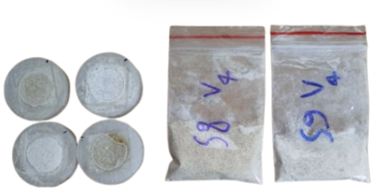
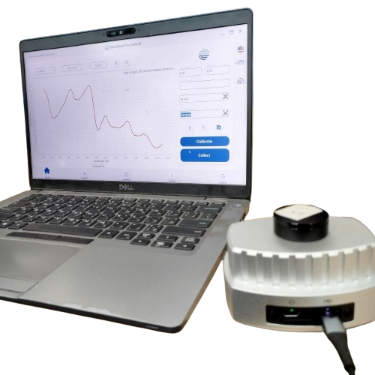
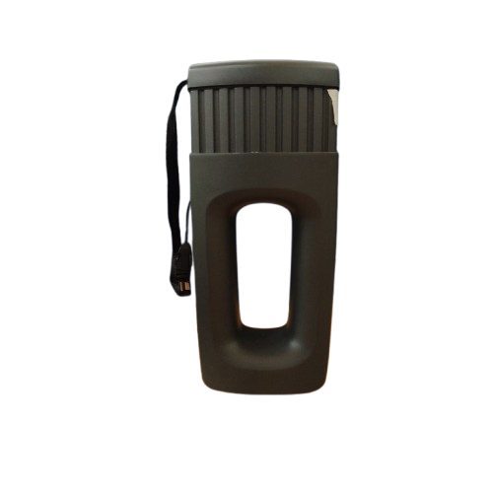
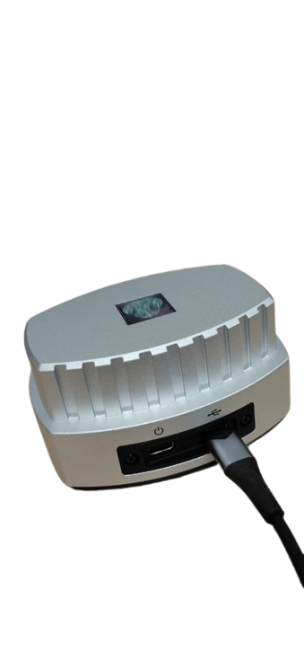
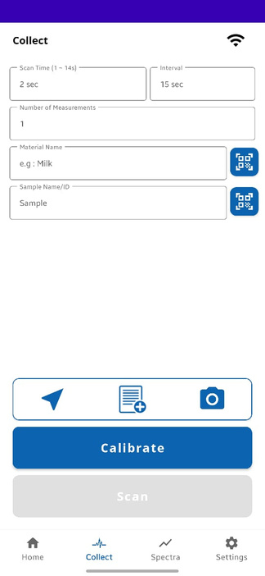
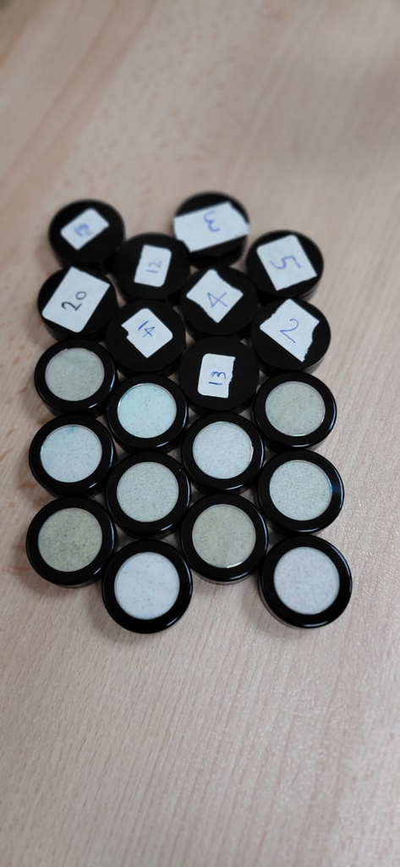
Project Objectives

Slide 11
Methodology
LHS of Calibration Sets
Spectral Data Acquisition HW
Preprocessing, Modeling
Evaluation, PCA

Slide 12

LHS
LHS (Latin Hypercube Sampling) is:
A statistical sampling method used to efficiently generate combinations of variables that cover the full range of each variable with minimal redundancy.
gives a well-distributed set of mixtures with fewer samples and lower correlation between variables.
Latin Hypercube Sampling (LHS) within the range of 0–10 grams for each of the 20 samples.
Each is the concentration value for each ingredient (Y label)

Slide 13
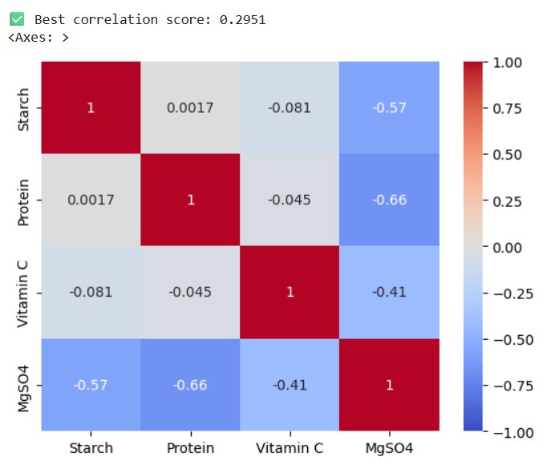
Correlation
Achieved an average inter-variable correlation of approximately 0.29
Converted grammatic values into percentages

Slide 14
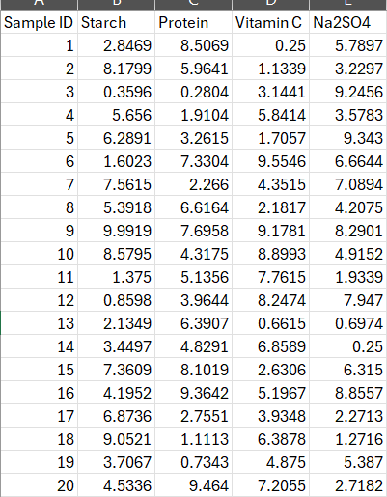
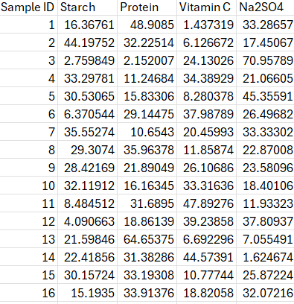
Normalization

Slide 15
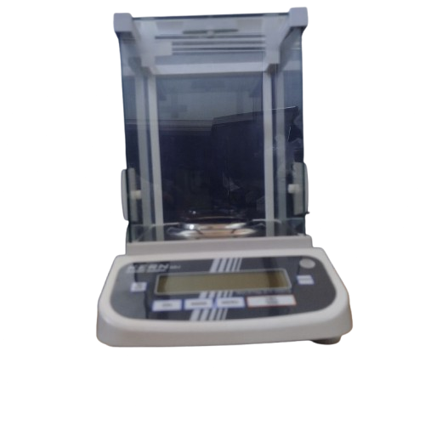
Data Acquisition
Weighed each sample using the sensitive balancing, preserving two decimal floating points.

Slide 16
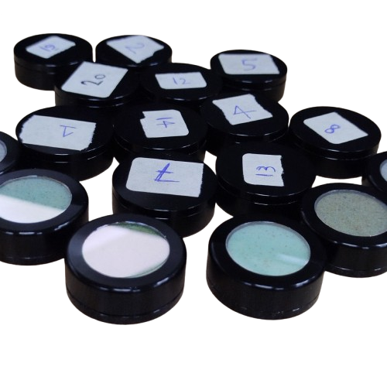
Scope of work
Sealed each sample in plastic bags to ensure homogeneity then glass holders.

Slide 17
Scope of work
Applied each sample to the reference spectrometer to obtain spectral data (X label)

Slide 18
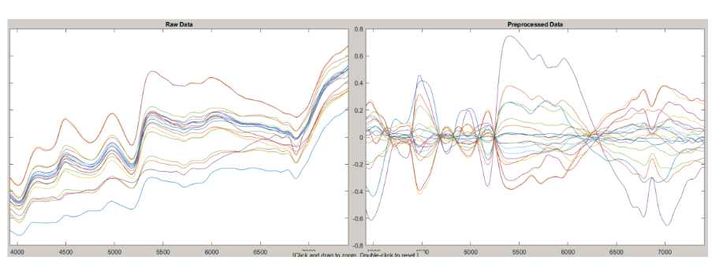
Scope of work
Built Partial least squares (PLS) regression model on a chemometrics software named SOLO.

Slide 19
Scope of work
After the initial trial resulted in suboptimal model performance due to multicollinearity.
a second experimental setup was designed to overcome previous issues.
Results for Model R2 Cross Validation score:
Starch : 0.62
Protein: 0.74
Vitamin C : 0.17
Na₂SO₄ (Salt) : 0.23

Slide 20
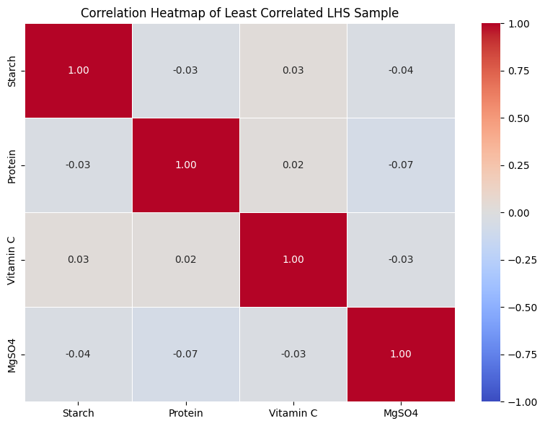
Scope of work
Achieved an average inter-variable correlation of approximately 0.0217

Slide 21
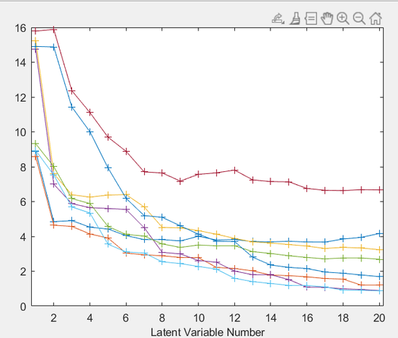
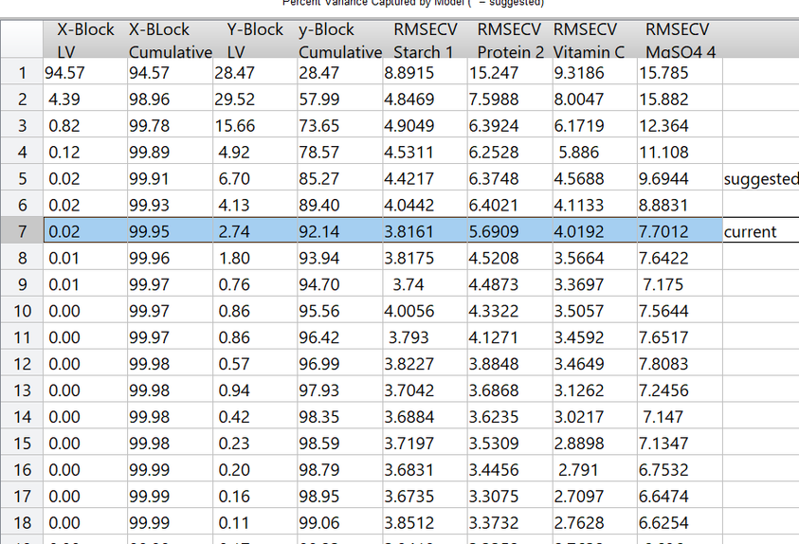
Scope of work
Built Partial least squares (PLS) machine learning model based on the obtained X and Y labels

Slide 22
Results
Model Improvement Factors:
Generated new samples without mass constraints.
Increased dataset size to 60 using oversampling.
Applied proper preprocessing
Results for Model R2 Cross Validation score:
Starch : 0.92
Protein: 0.86
Vitamin C : 0.91
Na₂SO₄ (Salt) : 0.75

Slide 23
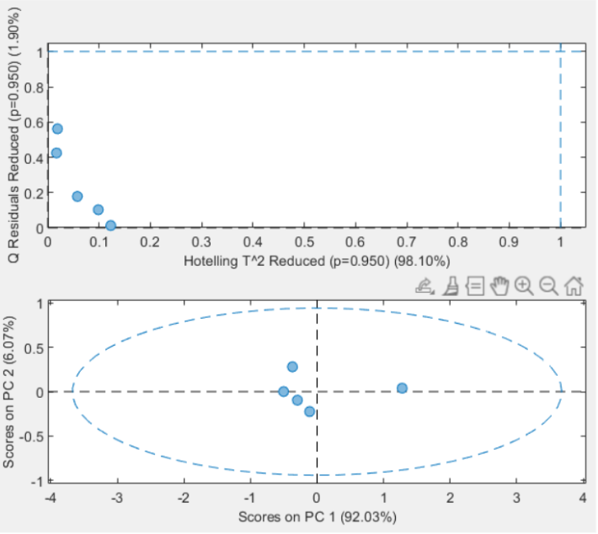
Results
PCA was applied to the full set of spectral data (20 spectra per device) to investigate hardware-induced variability (Backward compatibilty)

Slide 24

Challenges & Limitations
Relative small amount of spectrometers that were used
Each ingredient has different compostion
The dealing with sensitve balance
the company`s ownership for the devices

Slide 25




Thank you
Prepared by
Salma Bassem
Rowaina Reda

